Slide 1
Symposium on Teacher Education
February 27, 2020
Silver Springs Hotel, Kampala
Presenter: Craig Esbeck
Link to Practitioner Paper and Handouts:
mangotreelitlab.org/soted2

Slide 2
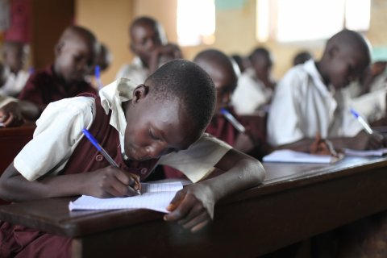
Children in Uganda have the right to learn to read and write and engage with knowledge in a language they know and understand.

Slide 3
Thematic Curriculum Policy of 2005
Drastically revised the early primary curriculum (P1-P3) to focus on literacy, numeracy and life skills.
Renewed focus on literacy in local languages with three 30-minute literacy lessons per day (reading lesson, writing lesson and oral literature/news).
Language of instruction in P1-P3 is completely in the local language. English is a 30-minute lesson each day. In P1 English is oral only so that children can focus on learning the alphabet and decoding in the local language.
New assessment policy that includes both competency-based and continuous assessment of pupils.

Slide 4
Mango Tree and Literacy Instruction
Teachers struggled with implementation of the new local language literacy policies.
Mango Tree saw the need for an explicit package of instruction materials. Jolly Phonics and BTL were not appropriate.
Robin Rempel’s Multi-Strategy Economy Model.
We worked with Robin to adapt her model for Uganda.

Slide 5
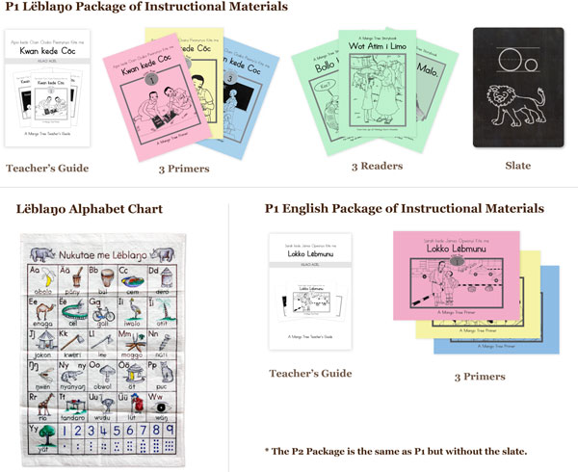

Slide 6
Results of Our Work in Lango Sub-region
An external evaluation of our small pilot in 2013 showed promising results.
Received funding for a scaled-up pilot with a Randomized Control Trial led by the University of Illinois in 2014-2016.
Full-Cost Program (intervention by Mango Tree staff); Reduced-Cost Program (intervention by CCTs); and Control.

Slide 7
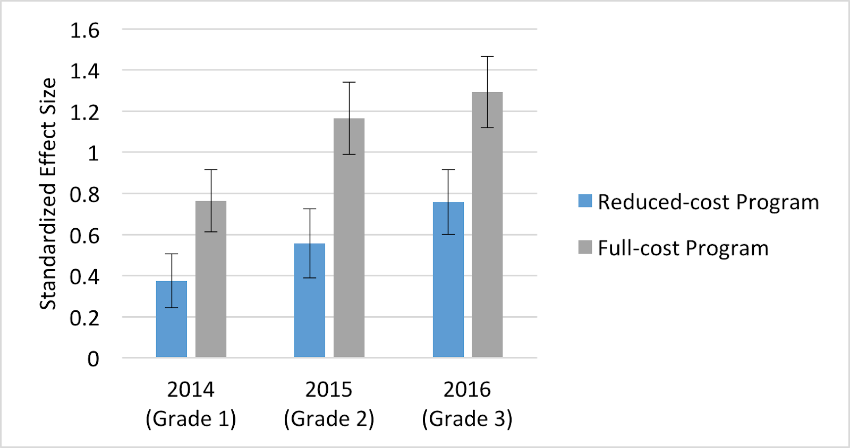
By the end of P3, our pilot raised reading scores by 1.2 standard deviations - the largest gain in reading ever achieved by an randomized education intervention, according to a systematic review of the literature (McEwan 2015).

Slide 8
Teacher Mentor Program 2017-19
Objective: Develop a cadre of experienced, mentor teachers in each district who are experts in implementing the National Literacy Model.
Recruited teachers throughout the sub-region through a rigorous application process.
Selected 240 P1 and P2 Teachers in 7 districts of the Lango Sub-region.
Used a Community of Practice training model based on two self-guided textbooks: one with a pedagogy focus and one with a language focus.

Slide 9
Assessment & Reporting Task Force 2019
Revised Continuous Assessment Monitoring (CAM) Forms for Literacy in P1-P3.
Developed CAM Forms for Math, RE and CAPE’s in P1-P3.
Developed End-of-Term Assessment Tests in Literacy and Numeracy for P1-P3.
Created Parent and District Report Cards that align with the continuous and end-of-term assessments.
Wrote a Teacher Assessment and Reporting Guidebook to provide instructions in how to use all the above tools.

Slide 10
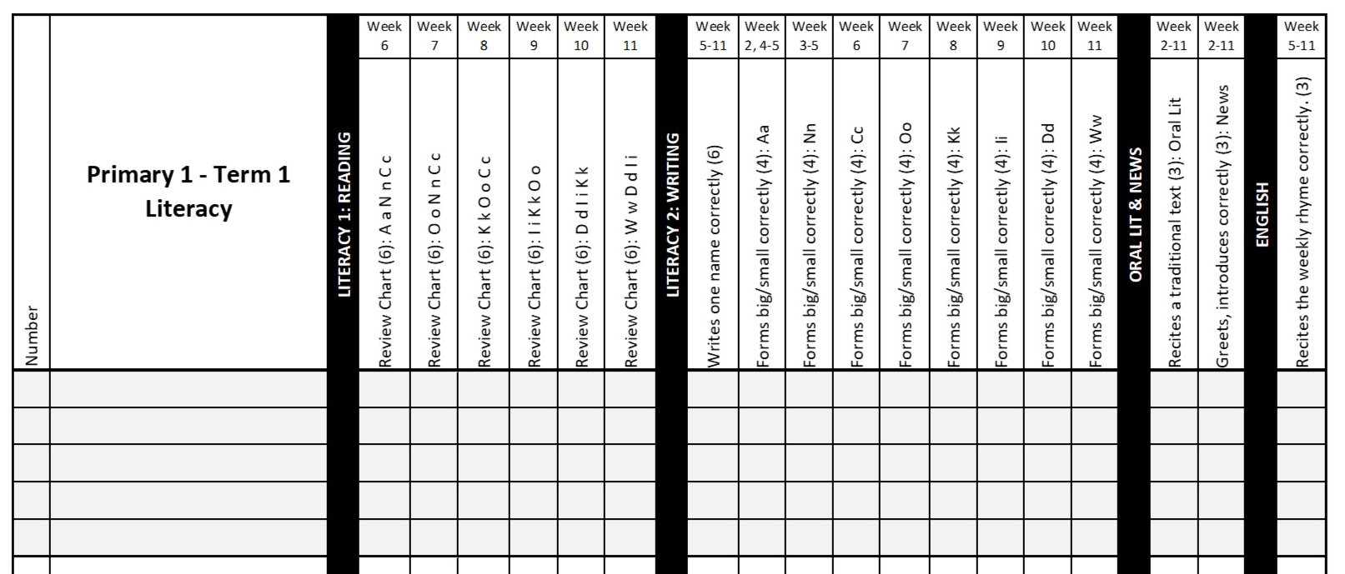
P1 Term 1 Literacy CAM Form

Slide 11
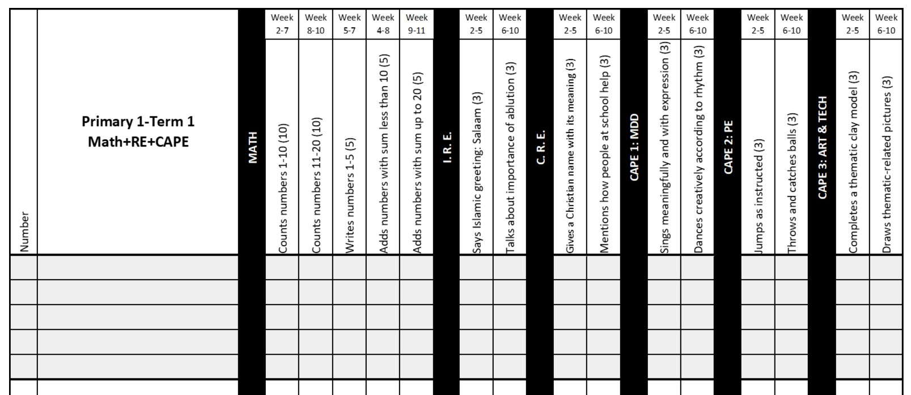
P1 Term 1 Math-RE-CAPE CAM Form

Slide 12
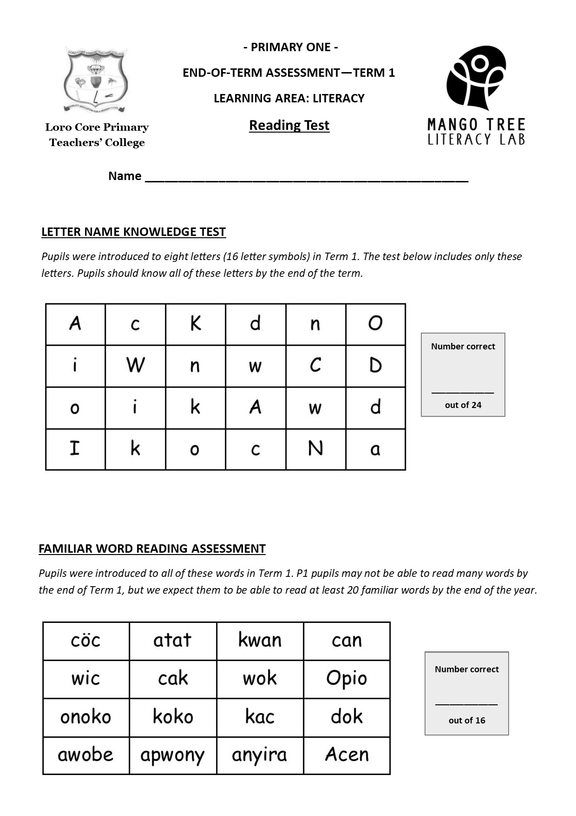
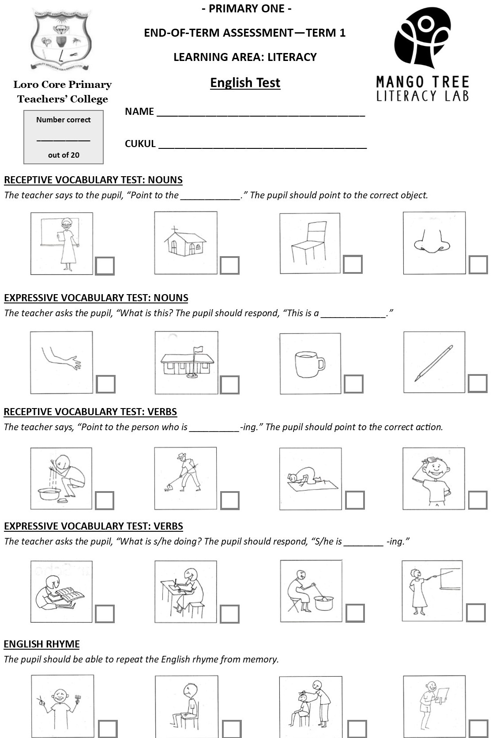
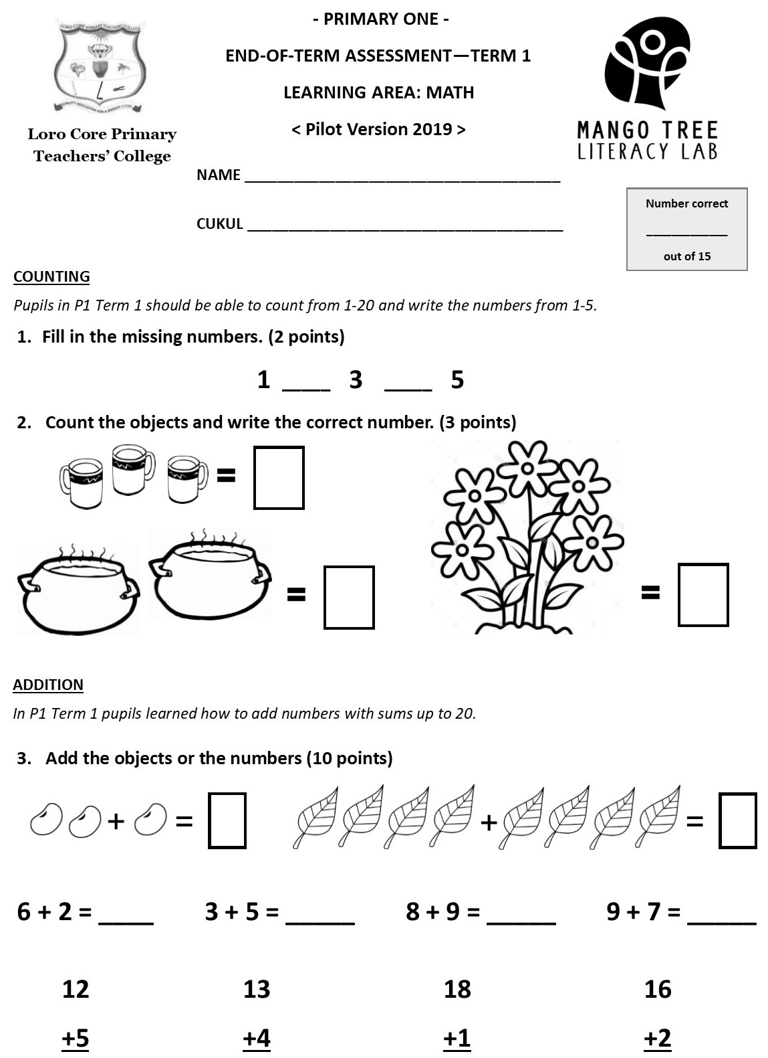
P1 Term 1 End-of-Term Tests

Slide 13
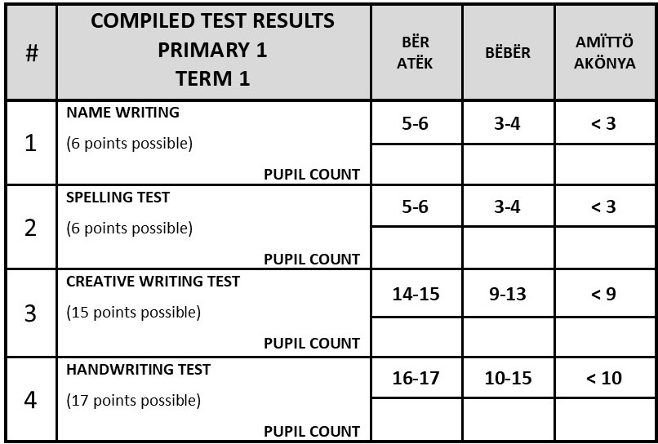
Teacher Analysis of End-of-Term Tests
Recording Form for entering individual pupil data on all end-of-term tests.
Compiled Test Results Analysis Form:

Slide 14
P1 Term 1 Parent & District Report Cards
Parent Report Cards are written in Leblango. The report card lists competences, NOT subjects. Closely linked to CAM Form and Termly Tests.
The report cards include scores for BOTH continuous and end-of-term assessment.
81%-100% Bër Atëk (BA); 50%-80% Bëbër (BB); < 50% Amïttö Akönya (AA)
Parent Report Cards also include a section on conduct (lifeskills).
District Report Cards provide key data on literacy progress in P1-3.

Slide 15
Community Awareness Campaign

Slide 16
Pupil Performance Data from TMP
External EGRA Data from November 2018 and 2019. (LNK in P1 and FWR in P2 highlighted)
Teacher Data 2018-2019: End-of-Term Assessments (LNK highlighted)

Slide 20
www.mangotreelitlab.org
Craig Esbeck
cesbeck@mangotreeuganda.org
0777-182-841

